Slide 1
JAVA DATATYPES ,VARIABLES AND KEYWORDS

Slide 2
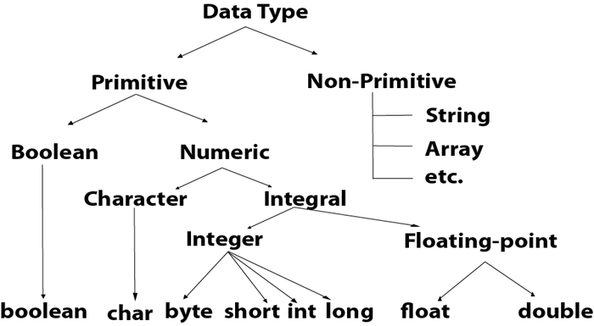
Datatypes
Datatypes are like containers that specifies what type of data to hold
Two types of Data types: Primitive and Non Primitive

Slide 3
Primitive Data types
byte b = 127; //8-bit
short s = 11; //16-bit
int i = 890; //32-bit - default for integers
long l = 4489309L; //64-bit
char c = 'c'; //Can store only a single letter
float f = 9.84f; //Decimal - use 'f' at end
double d = 483.846893; //Long decimal numbers - default for decimal
boolean bool = true; //Store only true or false

Slide 4
Non primitive Datatypes
String
Arrays
Interfaces
Class
etc

Slide 5
Type Casting
Assigning a value of one data type to variable of another data datatype
Two types:
Implicit Casting (Widening)
Explicit Casting (Narrowing)
Order of Data Types:
byte -> short -> char -> int -> long -> float -> double

Slide 6
Variables
public class A
{
static int m=100;//static variable
void method()
{
int n=90;//local variable
}
public static void main(String args[])
{
int data=50;//instance variable
}
}
Variable is the name allocated to the reserved memory space
Eg: int even = 2; -> Here ‘even’ is the variable name given by the user
There are three types of variables in Java:
Local variable
Instance variable
Static variable

Slide 7
KEYWORDS
Keywords are the reserved words in Java
They cannot be used to name the variables, objects, or classes
There are 49 used keywords and 2 unused keywords in Java (const and goto)

